Slide 1
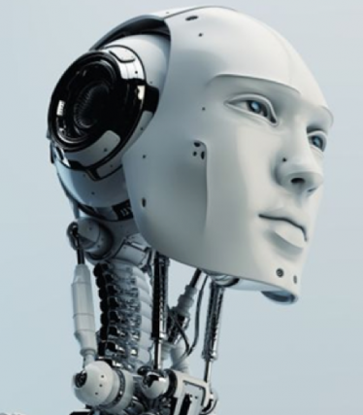
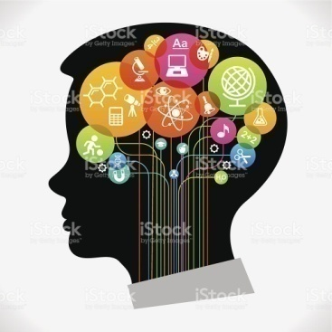
Artificial Intelligence (AI)
University of Science and Technology
Faculty of Computer Science and Information Technology
4th Year B.Sc : Information Technology
Academic Year : 2017-2018
Instructor : Diaa Eldin Mustafa Ahmed
Introduction to AI –(1/2)

Slide 2
Overview of Human Intelligence and Science challenges
Philosophers have been trying for over two thousand years to understand and resolve two big questions of the universe:
    How does a human mind work ? And
    كيف يعمل عقل الإنسان
    Can non-humans (machines/ Software) have minds?
    هل من الممكن أن يكون (للآلات /البرمجيات) عقل
However, these questions are still unanswered .
AI - (2017-2018) -Diaa Eldein Mustafa - Lecture (0) -Introduction to Artificial Intelligence

Slide 3
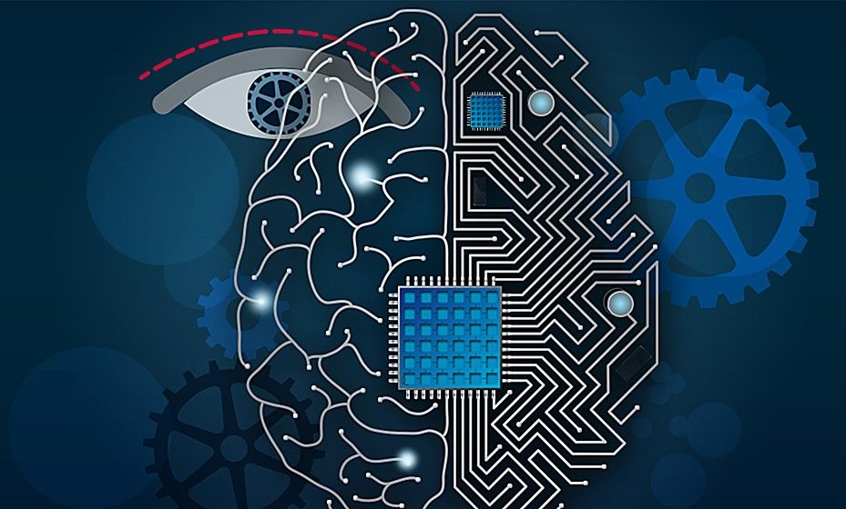
Overview of Human Intelligence and Science Challenges
AI -(2017-2018) -Diaa Eldein Mustafa - Lecture (0) -Introduction to Artificial Intelligence

Slide 4
Overview of Human Intelligence and Science challenges
Some philosophers have picked up the computational approach originated by computer scientists and accepted the idea that machines can do everything that humans can do.
Others have openly opposed this idea, claiming that such highly sophisticated behaviors such as love, creative discovery and moral choice will always be beyond the scope of any machine.
AI - (2017-2018) -Diaa Eldein Mustafa - Lecture (0) -Introduction to Artificial Intelligence

Slide 5
Overview of Human Intelligence and Science challenges
The nature of philosophy allows for disagreements to remain unresolved.
In fact, engineers and scientists have already built machines that we can call ‘intelligent’. So what does the word ‘intelligence’ mean?
Let us look at a dictionary definition.
1 - Someone’s intelligence is their ability to understand and learn things.
2 - Intelligence is the ability to think and understand instead of doing things by instinct or automatically
AI - (2017-2018) -Diaa Eldein Mustafa - Lecture (0) -Introduction to Artificial Intelligence

Slide 6
What is Human Intelligence ?
It is composed of :
Thinking (abstractly, using analogies)
Learning and understanding from experience
Knowledge applying successfully in new situations
Acting in complex environments,
Perceiving one’s environment
Automated behaviors.
Solve problems and to make decisions.
Pattern matching and recognition.
Reasoning (to solve problems and discover hidden knowledge)
Inference and prediction.
Perception.
Analysis .
Linguistic Intelligence.
Creativity , Ingenuity , Expressive-ness, Curiosity.
AI - (2017-2018) -Diaa Eldein Mustafa - Lecture (0) -Introduction to Artificial Intelligence

Slide 7
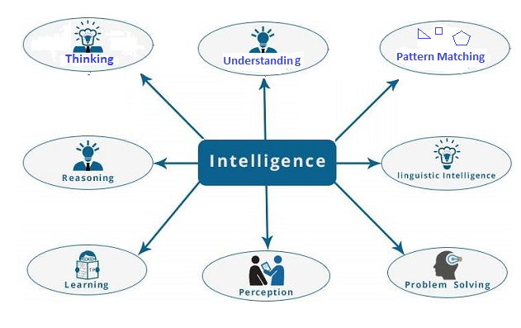
What is Human Intelligence ?
AI - (2017-2018) -Diaa Eldein Mustafa - Lecture (0) -Introduction to Artificial Intelligence

Slide 8
What is Intelligent Systems ?
The ability of a system to :
  Calculate
  Reason
  Perceive relationships and analogies
  Learn from experience
  Store and retrieve information from memory
  Solve problems, comprehend complex ideas
  Use natural language fluently
  Classify, generalize, and adapt new situations.
AI - (2017-2018) -Diaa Eldein Mustafa - Lecture (0) -Introduction to Artificial Intelligence

Slide 9
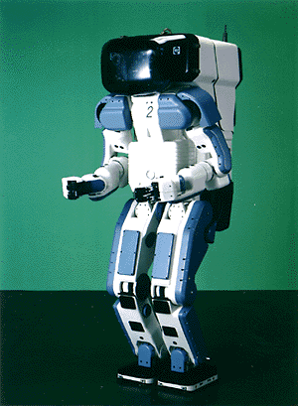

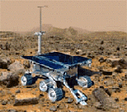

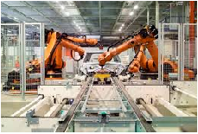
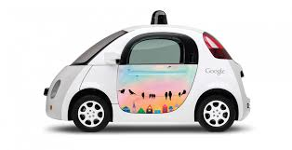
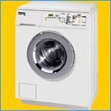
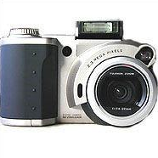

Why study AI?
Medicine/
Diagnosis
Internet
Search engines
Science
Labor
Science
Industry
Automation
Self-Driving
What else?
Appliances
AI - (2017-2018) -Diaa Eldein Mustafa - Lecture (0) -Introduction to Artificial Intelligence

Slide 10
Course Learning Outcomes
At the end of this course the students should be :
Knowledge and Understanding
You should have a knowledge and understanding of the basic concepts of Artificial Intelligence including problem solving ,Search strategies , Knowledge Representation(KR) ,Game playing , Machine Learning, Expert Systems , Fuzzy Logic and Neural Networks (NN).
Intellectual Skills
You should be able to use this knowledge and understanding of appropriate principles and guidelines to synthesise solutions to tasks in AI and to critically evaluate alternatives.
Practical Skills
You should be able to use a well known declarative language (Prolog) and to construct simple AI programs .
AI - (2017-2018) -Diaa Eldein Mustafa - Lecture (0) -Introduction to Artificial Intelligence

Slide 11
Course Learning Outcomes
Transferable Skills
You should be able to solve problems and evaluate outcomes and alternatives
AI - (2017-2018) -Diaa Eldein Mustafa - Lecture (0) -Introduction to Artificial Intelligence

Slide 12
Course Contents and Schedule
Introduction to AI (Lecture 0,1)
  Definition
  History
  Applications
  The state of art and research areas
Intelligent Agents (Lecture 2,3)
  Agents and environment
  Good behavior
  The concept of rationality
  The nature of environments
  Structure of agents
AI - (2017-2018) -Diaa Eldein Mustafa - Lecture (0) -Introduction to Artificial Intelligence

Slide 13
Course Contents and Schedule
Problem Solving (Solving Problems by Searching strategies) (lecture 4 ,5)
  Uninformed Search
  Breadth-First Search(BFS)
  Uniform-Cost Search(UCS)
  Depth-First Search(DFS)
  Depth-Limited Search(DLS)
  Iterative deepening search
  Heuristic Search
  Best First Search
  Constraint Satisfaction Problems (CSP)
  Game Tree Search
AI - (2017-2018) -Diaa Eldein Mustafa - Lecture (0) -Introduction to Artificial Intelligence

Slide 14
Course Contents and Schedule
Representation of knowledge (lecture 6)
  Propositional logic
  first order predicate logic
Knowledge inference (lecture 7,8)
  Production based system
  Frame based system.
  Inference - Backward chaining
  Forward chaining
  Rule value approach
  Fuzzy reasoning
AI - (2017-2018) -Diaa Eldein Mustafa - Lecture (0) -Introduction to Artificial Intelligence

Slide 15
Course Contents and Schedule
Expert systems (lecture 9)
  Architecture of expert systems,
  Roles of expert systems
  Knowledge Acquisition ,Meta knowledge, Heuristics
  Typical expert systems - MYCIN, DART, XOON
  Expert systems shells.
Machine Learning (Lecture 10)
  A General Model of Learning
  Types of Learning Systems
  Knowledge-Free Inductive Learning Systems
  Learning from Single Examples
AI - (2017-2018) -Diaa Eldein Mustafa - Lecture (0) -Introduction to Artificial Intelligence

Slide 16
Course Contents and Schedule
Fuzzy Logic (Lecture 11,12)
  What is Fuzzy Logic?
  Fuzzy Logic Systems Architecture
  Fuzzy Set Theory
  Crisp and Non-Crisp Set
  Membership Function
  Application Areas of Fuzzy Logic
Neural Networks (Lectures 13 ,14)
  Introduction, or how the brain works ?
  The neuron as a simple computing element
  The perceptron
  Multilayer neural networks
AI - (2017-2018) -Diaa Eldein Mustafa - Lecture (0) -Introduction to Artificial Intelligence

Slide 17
Assessment Criteria
Test at the 8th week 20 %
Course Works ( Laboratory Assignment)20%
Attendance 0 %
Final Exam 60 %
* Each student absent more than 4 lectures will be withdrawn the final exam , and their grade in this subject will be “C” in the supplementary exam.
AI - (2017-2018) -Diaa Eldein Mustafa - Lecture (0) -Introduction to Artificial Intelligence

Slide 18
Attendance
I expect you they attend all the lectures.
The lecture notes(docx) and Power Point(ppt) presentations dropped in (acadox.com) cover all the topics.
These notes are do not contain much details of discussion.
The lectures will consist of slides (Power-point ), spoken material, and additional examples given on the blackboard.
In order to understand the subject and the reasons for studying the material you will need to attend the lectures and take notes to supplement lecture slides.
This is your responsibility. If there is anything you do not understand during the lectures, then ask, either during or after the lecture.
In addition ,you must use the text book to supplement the lecture material by reading around the subjects.
.
AI - (2017-2018) -Diaa Eldein Mustafa - Lecture (0) -Introduction to Artificial Intelligence

Slide 19
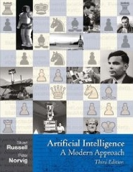
Text Books and References
Text Book:Artificial Intelligence: A Modern Approach, Stuart J. Russell and Peter Norvig , 3rd Edition 2010
AI - (2017-2018) -Diaa Eldein Mustafa - Lecture (0) -Introduction to Artificial Intelligence

Slide 20
Thank You
End
Questions ?
AI - (2017-2018) -Diaa Eldein Mustafa - Lecture (0) -Introduction to Artificial Intelligence

